Slide 1
CHAPTER-4
CPU Design

Slide 2
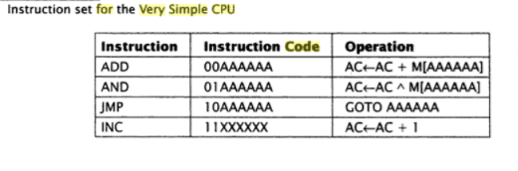
=>In order to illustrate CPU design process, consider small and somewhat impractical CPU. =>This CPU will have only one programmable accessible register called accumulator(AC). =>It has only 4 instruction in its instruction set as shown in table:

Slide 3
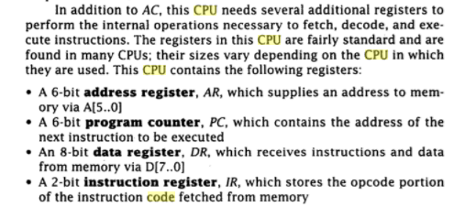
Contd..

Slide 4
Fetching instruction from memory
The address of instruction to be fetched is stored in the PC. Since, address register(AR) supplies an address to memory through A[5……0] pins, firstly copy the content of PC to AR. Fetch 1: AR <- PC
The CPU must read the instructions from the memory and store in DR. Fetch 2: DR <- M, PC <- PC + 1
Finally, two higher order bits of DR are copied into IR; these two bit indicate which instruction is to be executed, and the CPU copies the lower order 6-bit of DR into AR. Fetch 3: IR <- DR[7,6], AR <- DR[5….0]

Slide 5
Decoding instructions
The CPU must determine which instruction it has fetched so as to invoke the current routine.
The value of IR i.e. 00, 01, 10 and 11 determine which routine is to be invoked.

Slide 6
Executing instructions:
ADD instruction: => First it must fetch one operand from the memory. => Then, it must add this operand to the current content of accumulator and store the result back into the accumulator. ADD1: DR <- M ADD2: AC <- AC + DR
AND instruction: AND1: DR <- M AND2: AC <- AC ^ DR
JMP instruction: => The address to which the CPU must jump is copied into the PC. => Since, the result is already stored in DR[5…0], we simply copy this value to PC. JMP1: PC <- DR[5…0]
INC instruction: INC1: AC <- AC + 1

Slide 7
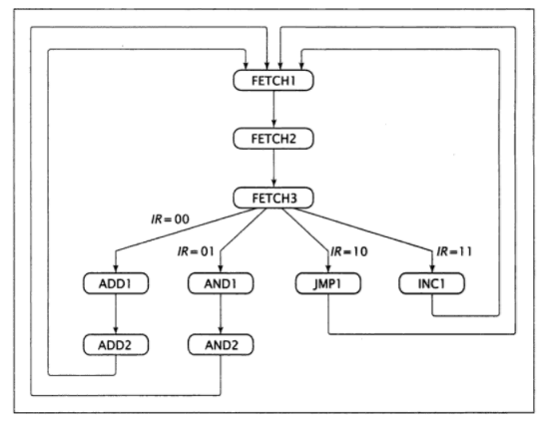
Complete state diagram for very simple CPU

Slide 8
Establishing required data path
Fetch 1: AR <- PC Fetch 2: DR <- M, PC <- PC + 1 Fetch 3: IR <- DR[7,6], AR <- DR[5….0] ADD1: DR <- M ADD2: AC <- AC + DR AND1: DR <- M AND2: AC <- AC ^ DR JMP1: PC <- DR[5…0] INC1: AC <- AC + 1

Slide 9
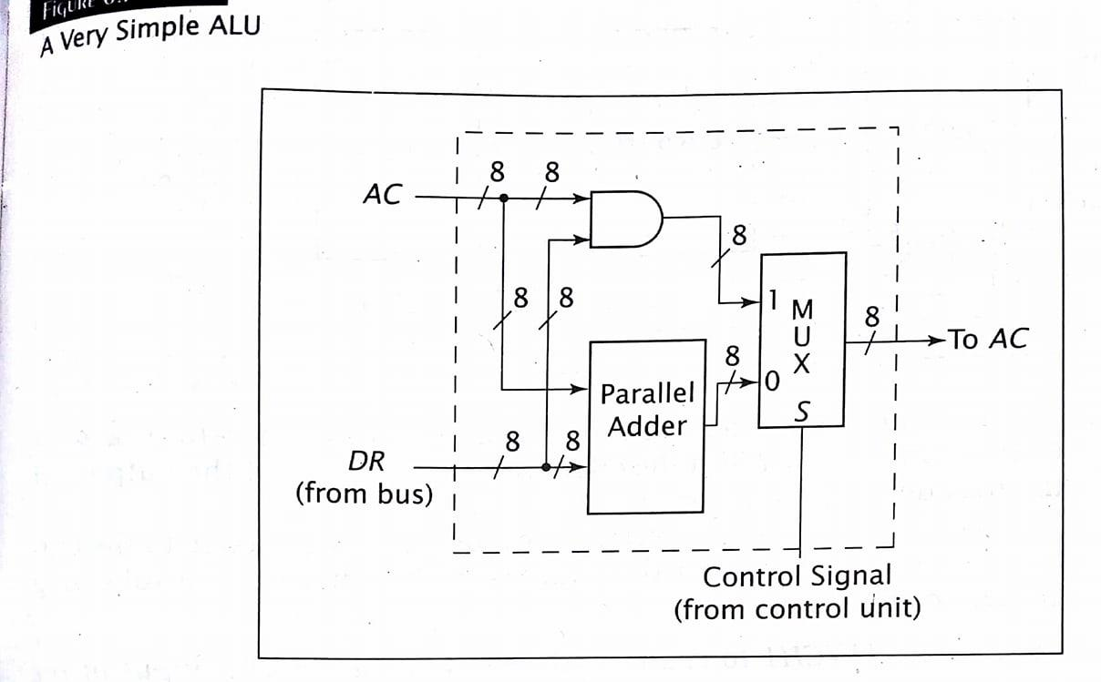
Design of very simple ALU

Slide 10
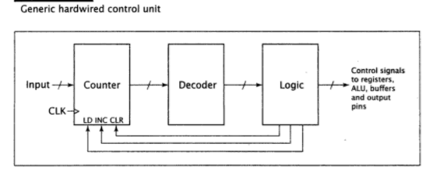
Designing Hardwired Control Unit: (This very simple CPU requires only a ordinary control unit which has three components: counter, decoder and some combinational logic)

Slide 11
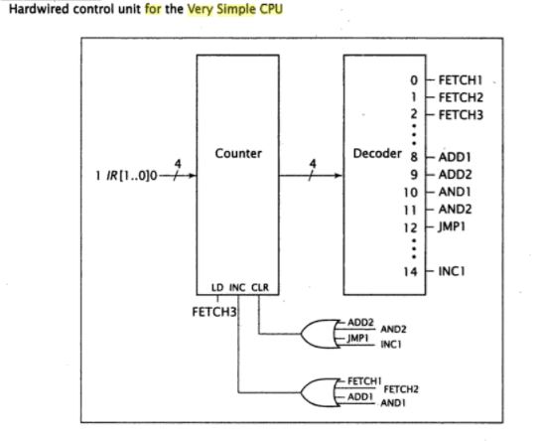
Contd.. (For this CPU, there are total number of 9 states and therefore a 4-bit counter and 4-to-16-bit decoder is needed)

Slide 12
Contd..
While working on the actual transfer, we note that AR only supplies its data to memory, but not to other components. Therefore, it is not necessary to connect its output to other internal bus.
IR does not supply data to any other components through the internal bus. So, its output connection can be removed.
AC actually does not supply data to any components. Therefore, its connection to the internal bus can be removed.
AC must be able to load the sum of AC and DR as well as logical AND of AC and DR. Therefore, the CPU needs to include ALU that can generate these results.

Slide 13
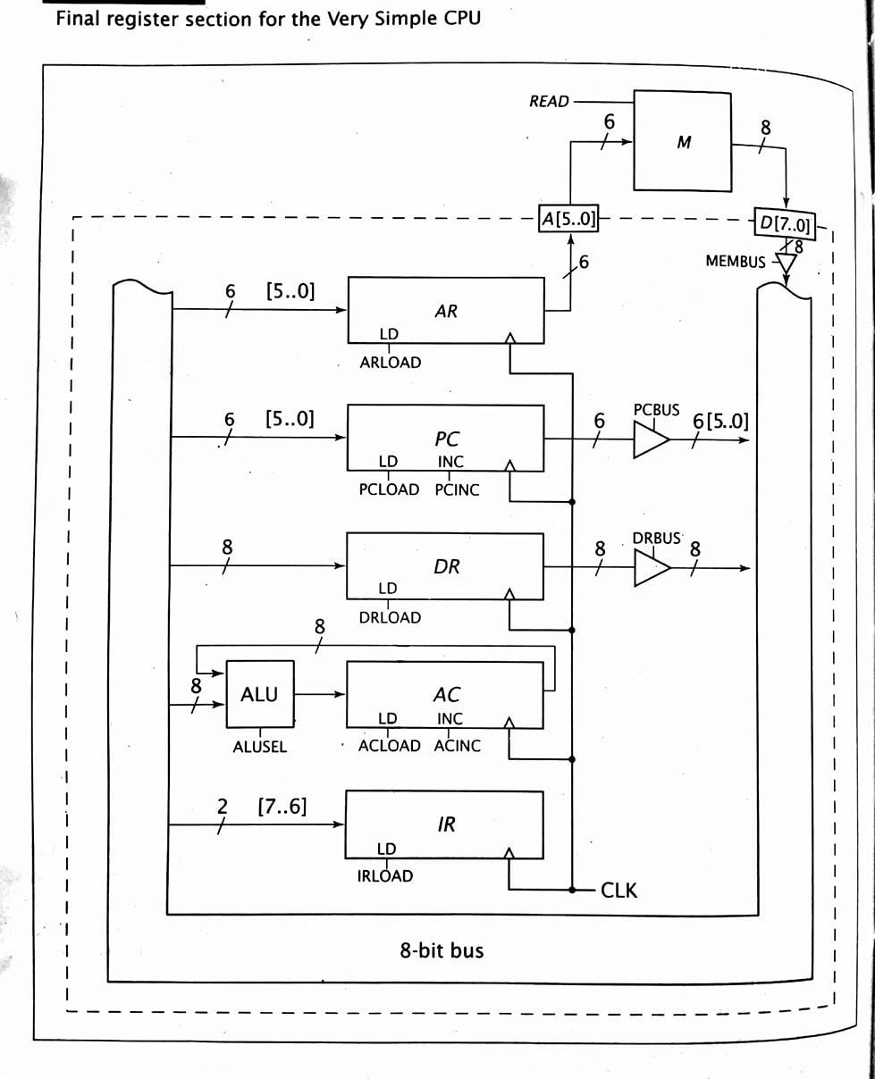
Contd…

Slide 14
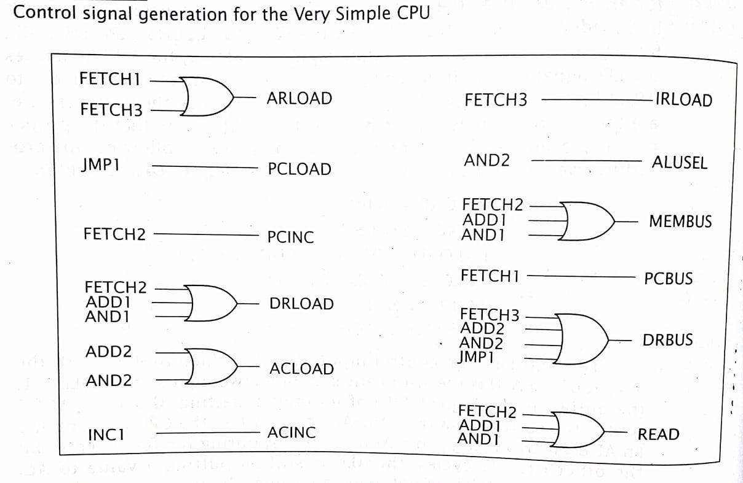
Control signal generation for very simple CPU

Slide 15
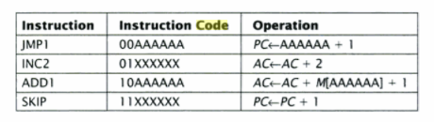
Example:

Slide 16
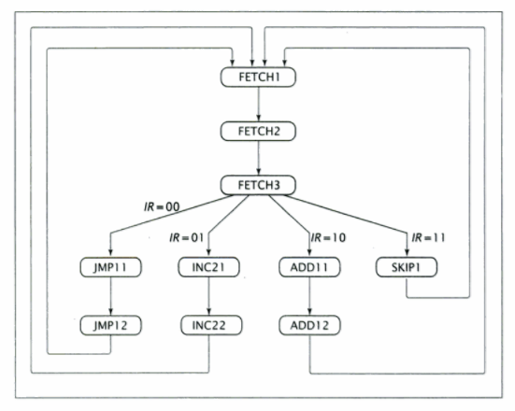
Contd…

Slide 17
Contd…
Fetch 1: AR <- PC Fetch 2: DR <- M, PC <- PC + 1 Fetch 3: IR <- DR[7,6], AR <- DR[5….0] JMP11: PC <- AR JMP12: PC <- PC +1 INC21: AC <- AC +1 INC22: AC <- AC +1 ADD11: DR <- M, AC <-AC + 1 ADD12: AC <- AC + DR SKIP1: PC <- PC +1

Slide 18
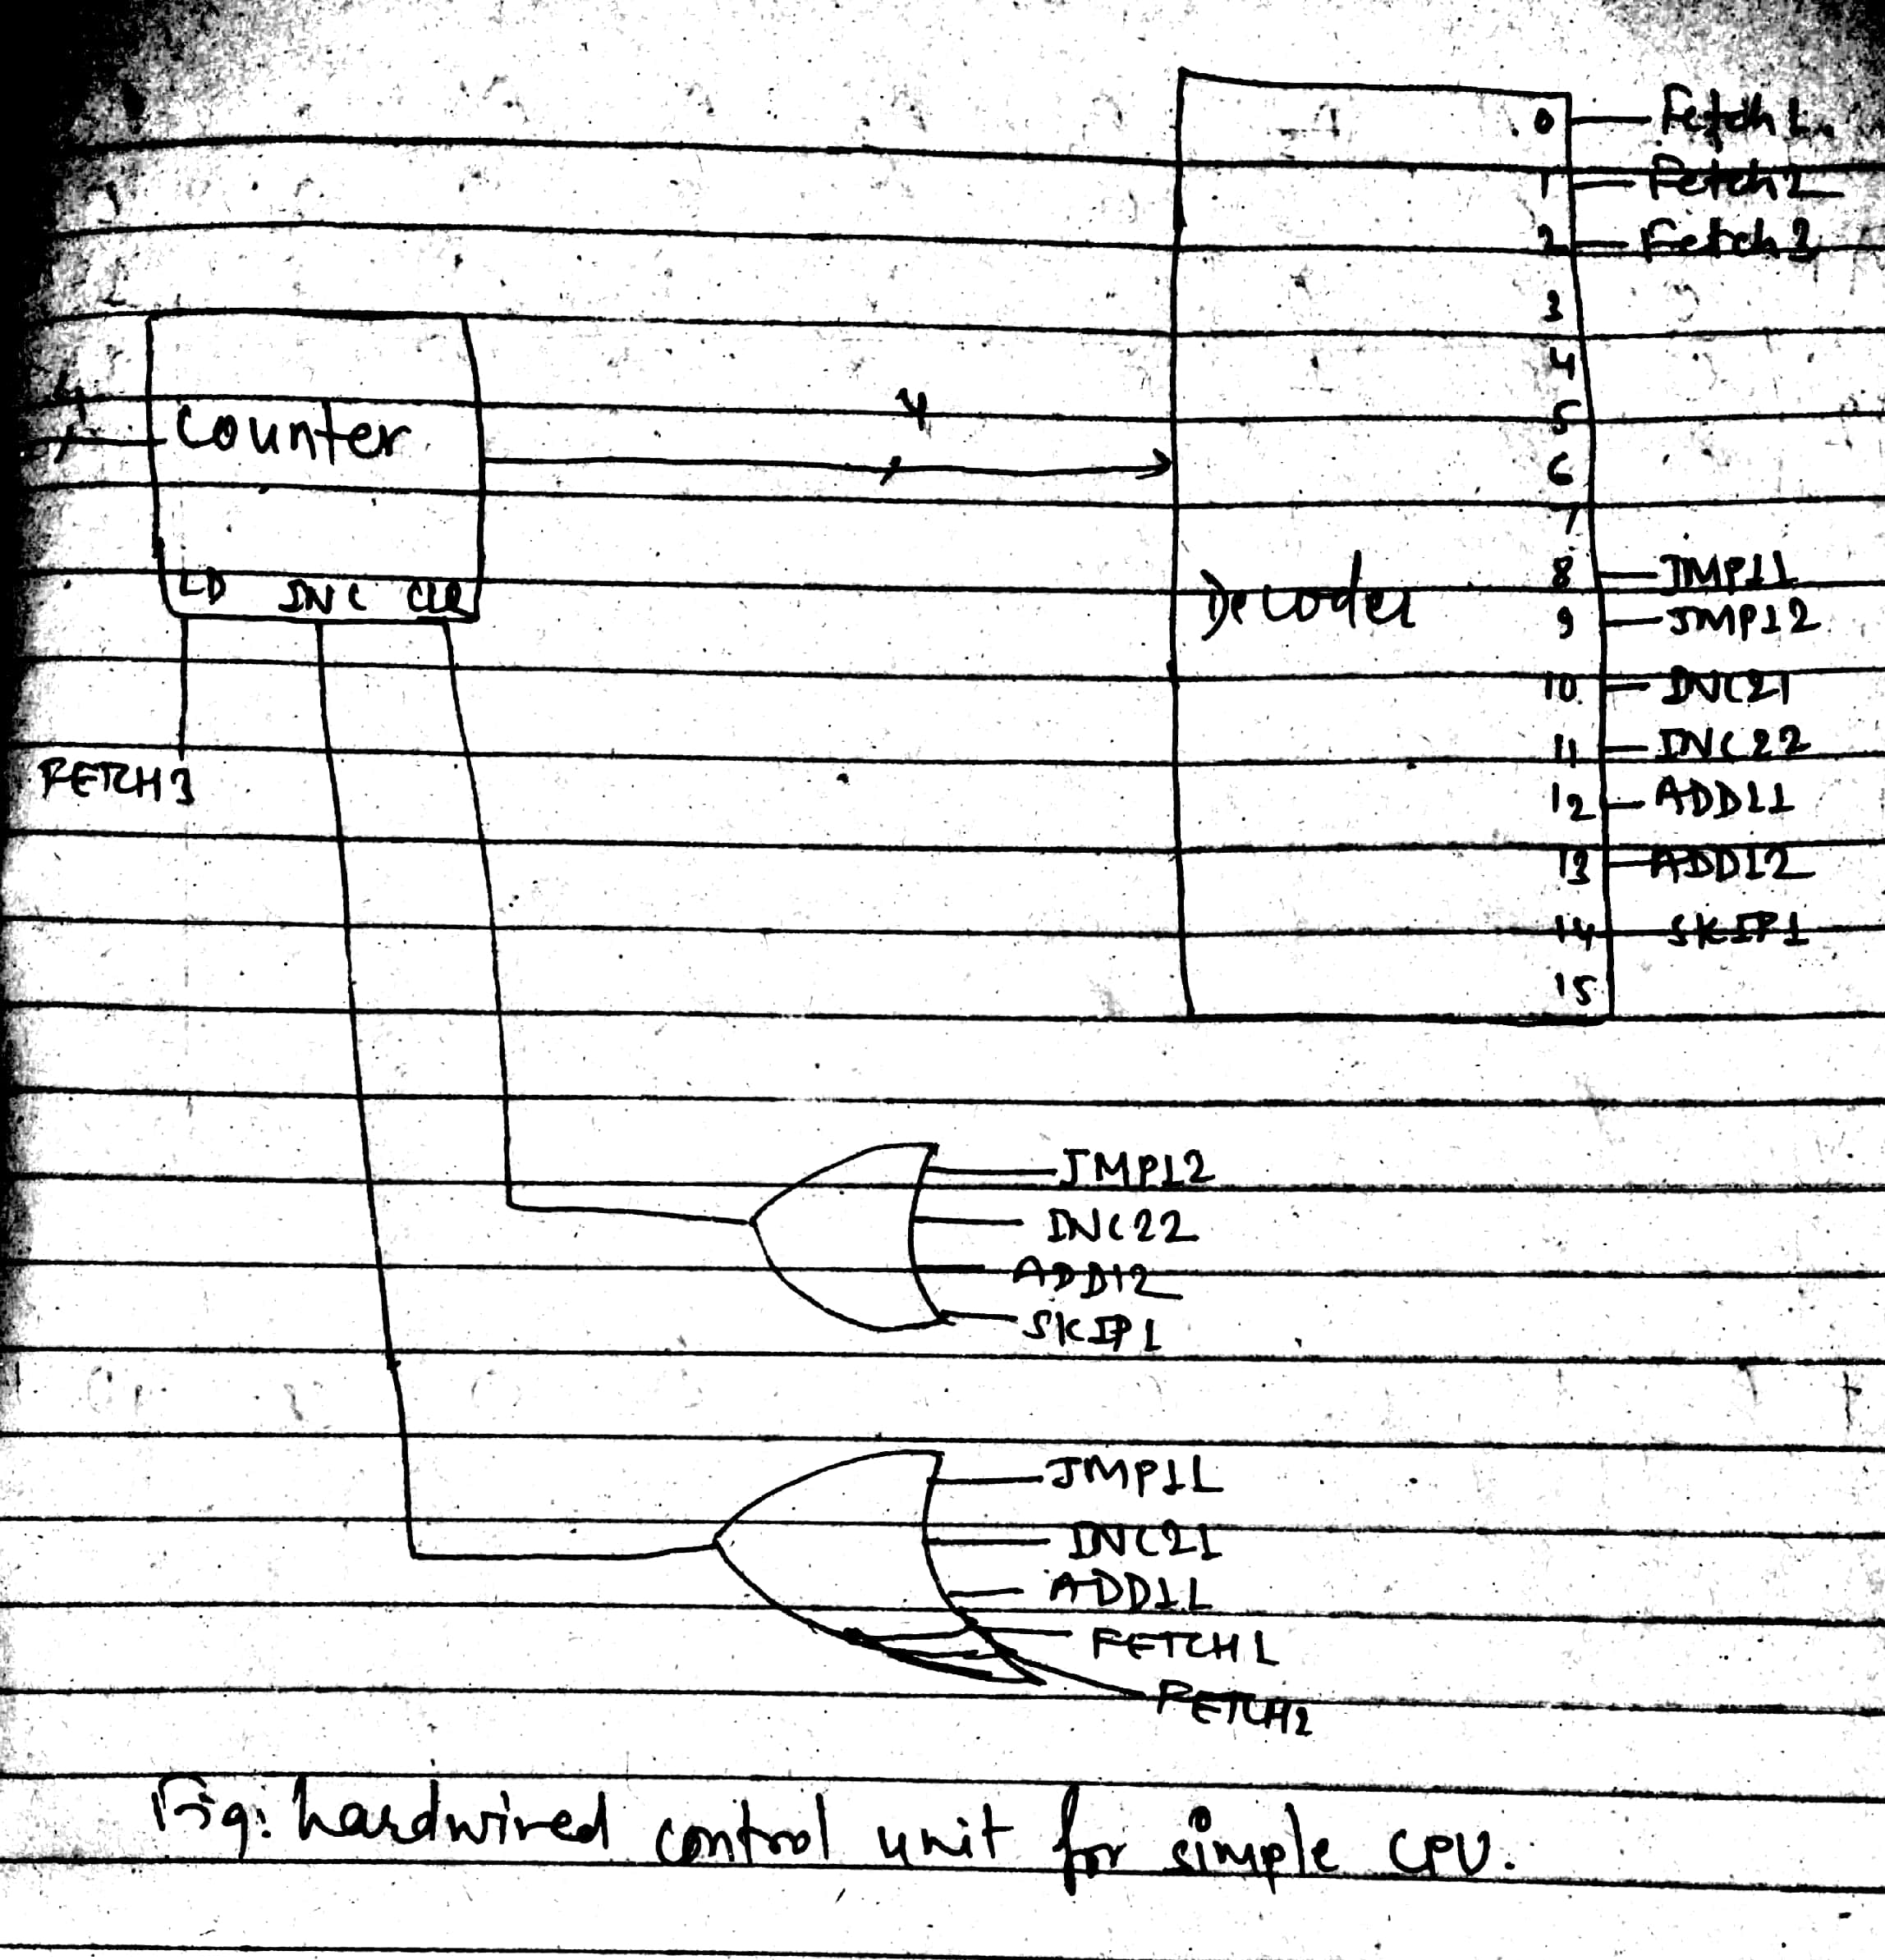
Contd..

Slide 19
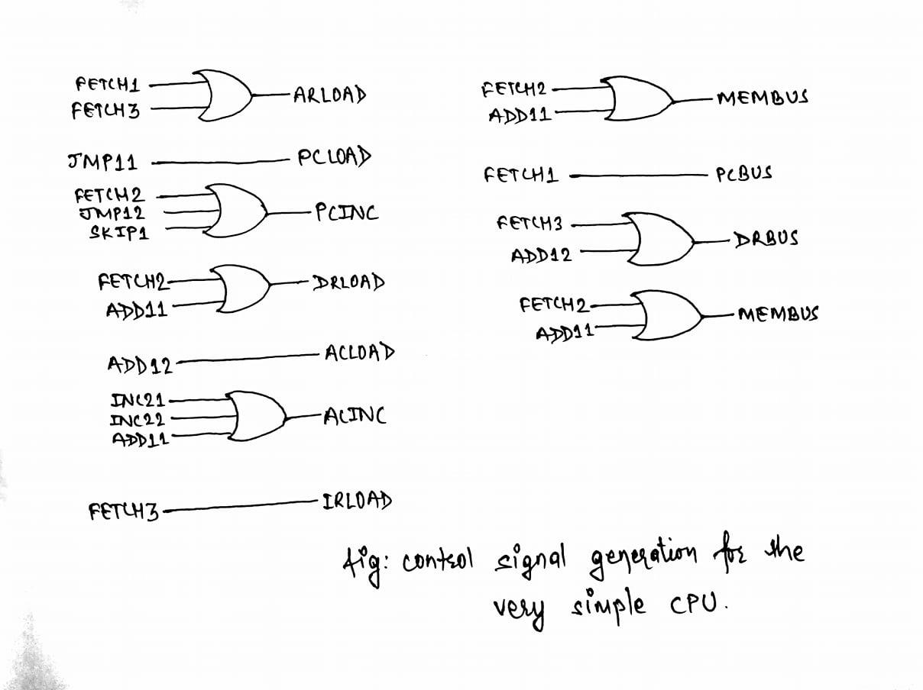
Contd…

Slide 20
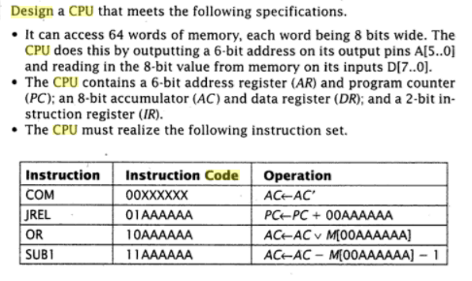
Example

Slide 21
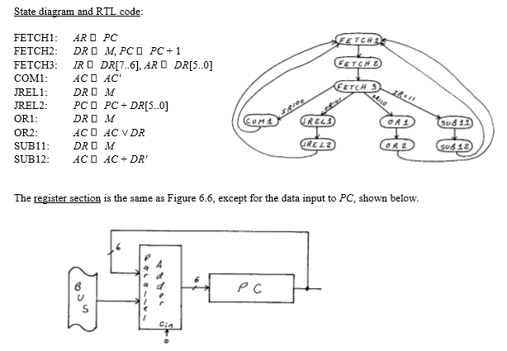
Contd…

Slide 22
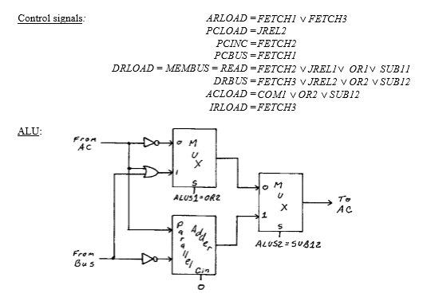
Contd..

Slide 23
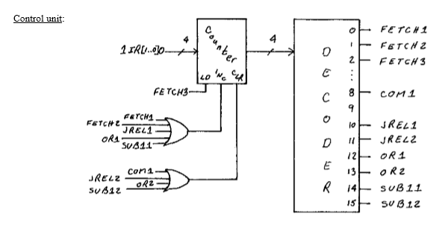
Contd..
Notes:
NOTE: For AC <- AC’ + 1 (NEG) NEG1: AC <- AC’ NEG2: AC<- AC + 1

